Slide 1
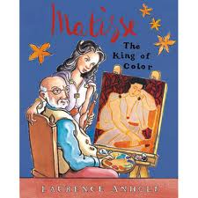
Matisse the King of Color
Text Talk
Kindergarten, Unit 1
Old Wire Road Elementary School

Slide 2
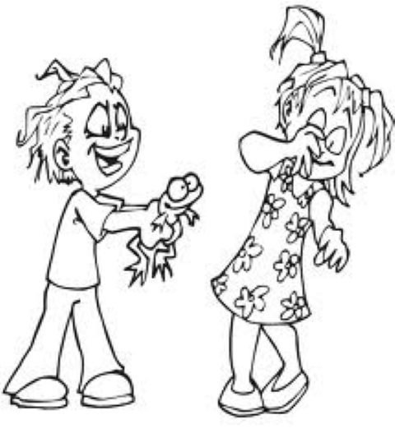
Teased: To bother someone
The boy teased the girl with a slimy frog.

Slide 3
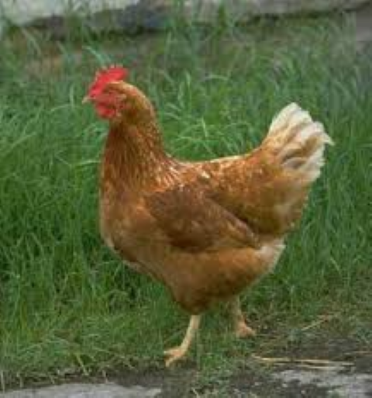
Ordinary: Normal
We saw an ordinary brown chicken at the farm.

Slide 4
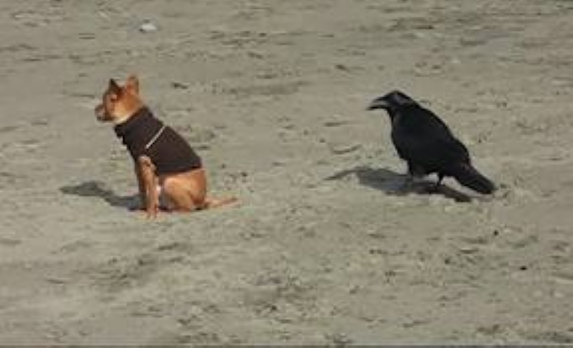
Crept: To move slowly and carefully like you are sneaking up on someone.
We watched the bird as he crept toward the dog.

Slide 5
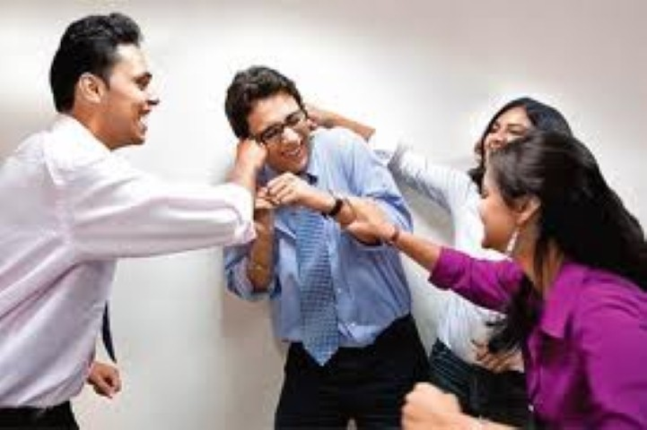
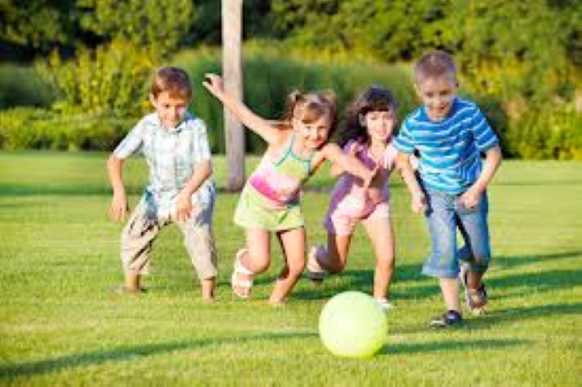
Which picture goes with teased?

Slide 6
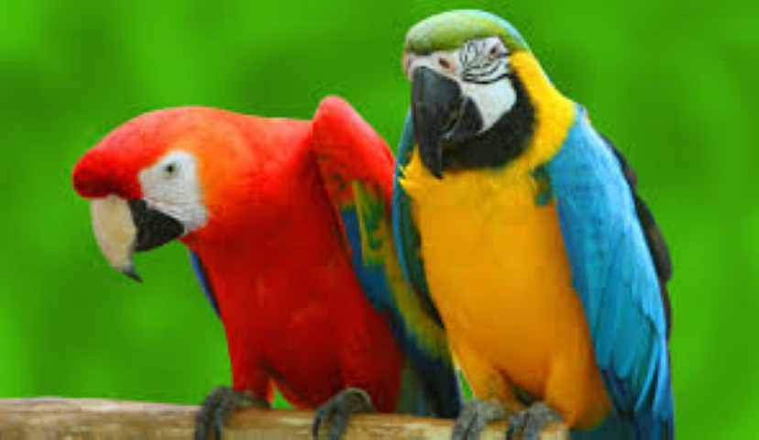
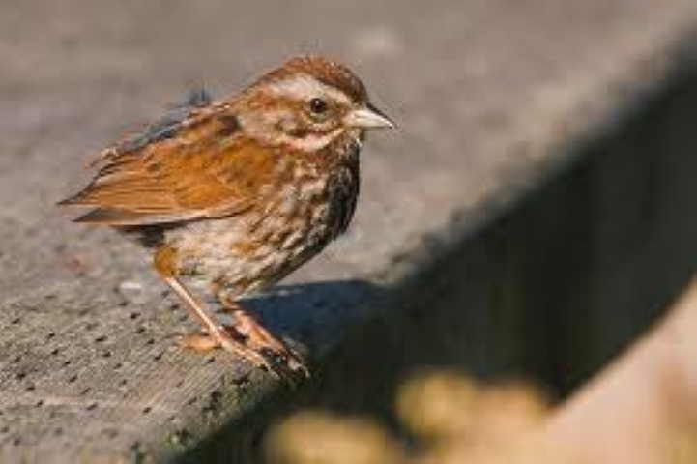
Which picture goes with ordinary?

Slide 7
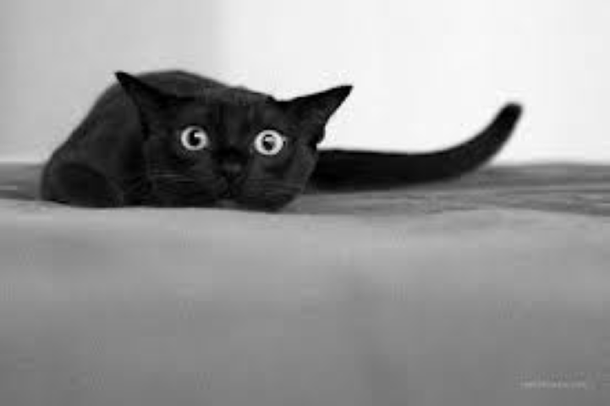
Which picture goes with crept?

Slide 8
Which word does this picture go with: teased, ordinary, or crept?

Slide 9
Which word does this picture go with: teased, ordinary, or crept?

Slide 10
Which word does this picture go with: teased, ordinary, or crept?

